Slide 1
EPrints for Administrators Training (3.4 Publication flavour) Part 1 – Introduction to EPrints
Kelly Terrell, EPrints Services, University of Southampton. 2022
Notes:
Welcome to the EPrints for Administrators online training course. The following collection of slides and walkthrough videos combined with opportunities for hands-on exercises on our training environment is intended to help you understand the core features of your EPrints repository that are available to a visitor, depositor, editor and of course the Administrator.
We will provide you with a holistic view of your EPrints repository focusing on the web interface, so Administrators are aware of their role and responsibilities within the system as well as other roles and their impact on one another.
Through a train the trainer approach you will be able to promote a shared understanding of knowledge and skills required for your team to deliver and maintain an effective and successful EPrints repository

Slide 2
Training course objectives
Acquire the skills and confidence to work with and develop your repository
To enable you to successfully manage your repository items
To identify customisations and potential enhancements
To understand the user roles and influence of their interactions
Notes:
The purposes of this course is all about raising your awareness of EPrints functions and how to get the best out of them which in turn will build your own confidence as your EPrints repository grows.
You will be able to identify the best ways of managing the content you intend to host in your Eprints repository and also gain a better understanding of all the user types of your repository and how you can support them.
This process will help you identify customisations and enhancements to the standard EPrints repository installation.

Slide 3
EPrints is about
It’s not about
Open Access (OA)
Self-archiving
Sharing research and other materials
Enabling greater visibility and dissemination
Enabling you to manage your research and other artefacts
Self-publishing
Publishing without quality controls
Sharing research for royalty revenue
The Individual AND The Institution
Notes:
This first slide is to give you awareness of what EPrints is really all about and what it is not about
What drives EPrints is about open access, sharing research outputs in the open in an appropriate form.
It's about self archiving, sharing research materials or other types of materials, it doesn't just have to be research that is hosted in an EPrints repository. Enabling greater visibility and dissemention - Getting the findings of the research out in the open so they can be discovered and used by other
As an organisation EPrints is also about you managing your research and other artefacts and having the collective knowledge of what exists.
EPrints is not about self publishing, people bypassing the peer review quality controls that exists and is certainly not about people sharing research for personal monetary return.
A number of these things can be seen from the individual and also the organisational perspective. What we mean by that is when you say 'enabling you to manage your research' that can be you as an individual you to know that all of your research outputs you have contributed to or produced are all in one place where they are looked after and they will be managed. Equally from the institution/organisation view you can know across the board that you have all of your outputs in one location in a standard quality control form.

Slide 4
Repository Interaction Layers
Web
OAI-PMH
Notes:
We are now going to consider the various ways that users, systems and other services can interact with your EPrints repository, which we describe as occurring is different layers.
The first interaction layer is via the Web and these are just some examples:
So the obvious one being Search engines. EPrints is optimised so that your repository content can be discovered easily by any search engine. The metadata that your record in your repository will be used to display search results such as in the example show here.
If you have uploaded the full-text file to your repository record and direct link from the search engine results will be included as shown the example of screen. As a result, users may be drawing content from your repository without ever visiting your repository pages personally.

Slide 5
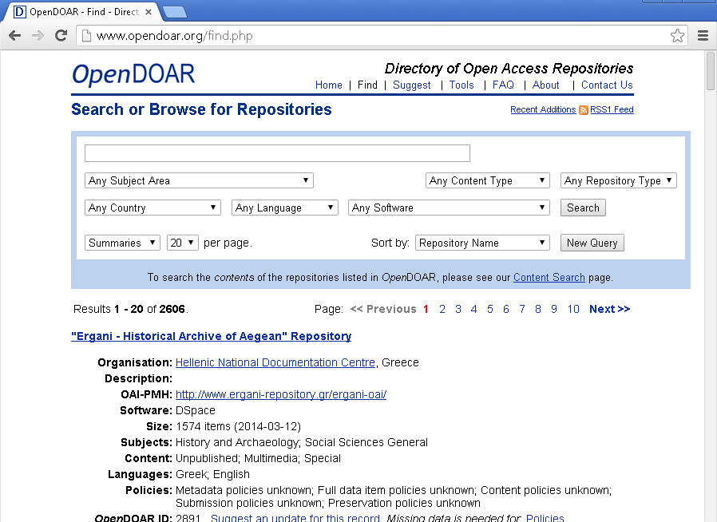
Repository Interaction Layers
Web
OAI-PMH
Notes:
Another way people may interact with your repository is through third party web based services that exist such as OpenDOAR - the Directory of Open Access Repositories
This online resource is valuable source of data for research and identification purposes so we would highly recommend that once your EPrint repository is live you submit a new directory entry for it here.
And finally it’s important to highlight that your EPrints repository includes data export features so your data can be requested by people interested in your content or third party services who may require them or simply wish to consolidate lots of related items from different sources in one place.
RSS feeds enabling users or other services to automatically keep up to date with live records on your repository where they can display them display them locally or simple read through them as part of a notification feed.
EPrints is also compliant with the Open Access Initiative Protocol for Metadata Harvesting meaning that is your EPrints repository is configured to a recognised interoperability standard to support harvesting by other services such as other standalone systems or aggregation services, all of which can aid the discovery of your repository content

Slide 6
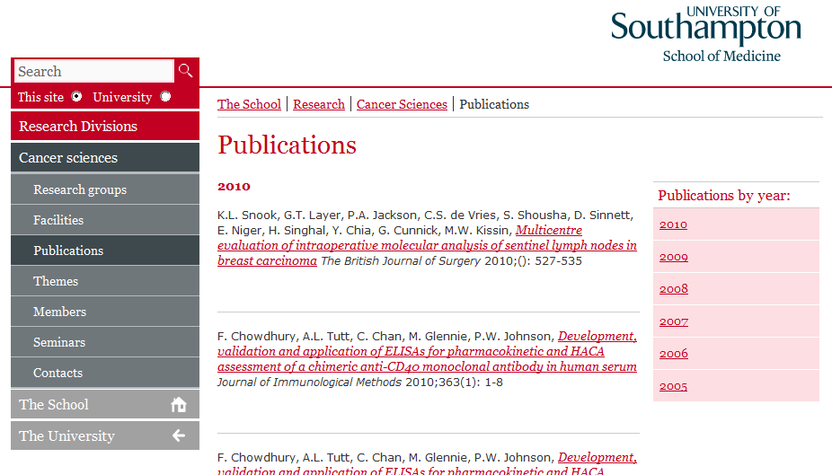
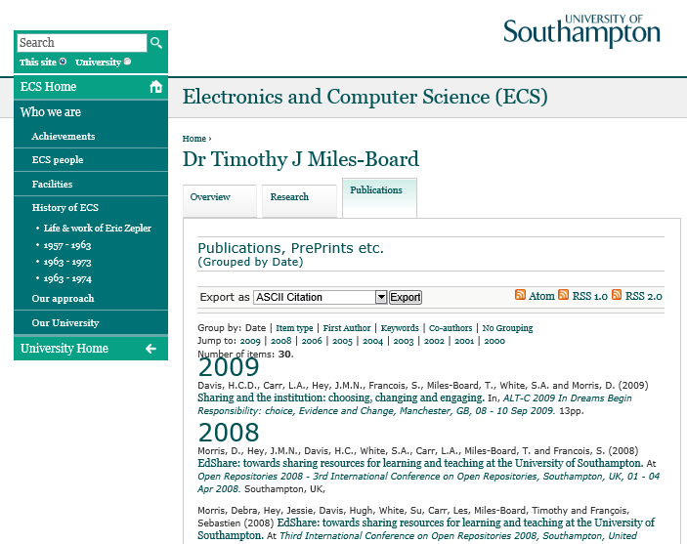
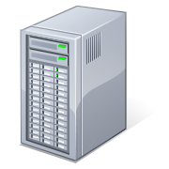
Repository Interaction Layers
Web
OAI-PMH
Institution
Notes:
For the second layer we are now refering to interactions that take place between EPrints and part of your institution or organisation.
EPrints does include its own user accounts and authentication that can be used for logging in, however the vast majority of EPrints repository owners now opt to integrate with Single Sign Authentication system. From a user perspective this means that your staff logins will be consistent with your other core systems and people will not need to remember another username and password. As an organisation it means that you remain in control of who can login to your system via your central account management policies.
If you have additional systems within your organisation such a bepoke management system that you need to migrate legacy data or require bulk updates of user account information, it’s possible to maintain a regular ongoing feed into your repository or a bulk one-off import if needed and many of our EPrints repository owners have such approaches to providing data feeds from other data sources within their institution.

Slide 7
Repository Interaction Layers
Web
OAI-PMH
Institution
Notes:
Through the use of RSS feed, include files, built in or customised export plugins it is possible for the data from your EPrints repository to appear in its live state in other locations.
In this example shown on screen a School website is taking a direct feed from the Browse view pages of the EPrints repository which is constructed to display in a specified order and already refined to only show records associated with this school and each record includes a link back to the repository.
This approach ensures that as soon a record is displayed on the EPrints repository the same information will appearing on the school website, there is no manual intervention needed and no duplication of effort in order for these publications to appears. The repository includes various ways of configuring which records appear and in what order so there is lots of flexibility to suit different needs.
In the case of the School of Medicine this approach was very successful in getting staff engagement with the EPrints repository as research outputs would need to be deposited in order for them to appear on their school website page where external bodies were looking for evidence of what research the school was doing. In turn great care and attention was taken to ensuring the best quality of information was provided and any mistakes were flagged up quickly to to EPrints editors as accuracy was of such importance to staff both personally and in terms of the school.

Slide 8
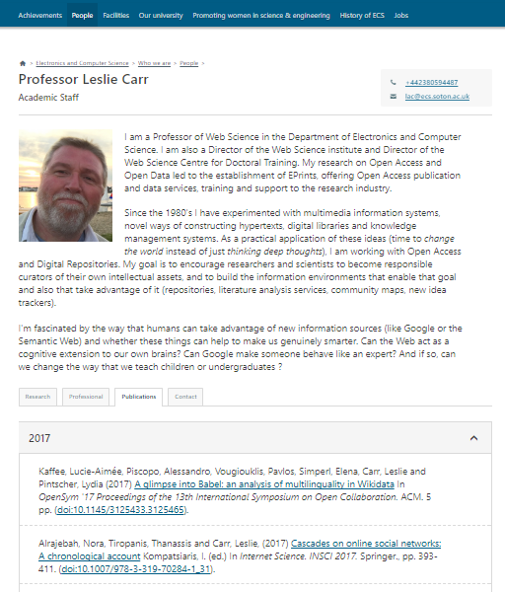
Repository Interaction Layers
Web
OAI-PMH
Institution
Notes:
As another example of how useful such feeds are you can also now see on screen an example of a Staff Profile page. Again these website pages are entirely separate from the EPrints repository. The vast majority of the information on these page is coming from local sources, but the dedicated Publications tab in this case is again populated by a live feed from the EPrints repository. This is achieved by mapping the unique identity of authors in the EPrints record with the Staff user identity through this unique key a feed of their publications is pulled through from the repository to appear directly on the profile pages.
If you don’t have your own Staff Profile pages are part of your own corporate or school/department level website, EPrints does have an extension available to provide such functionality on the repository so please get in touch with our teams if this is of interest.

Slide 9
Repository Interaction Layers
Web
OAI-PMH
Institution
Repository
Notes:
Our third layer we will be covering is direct user interaction with the repository itself. There are many options of customising and configuring your repository which we will touch on further as we progress through this course, but at this stage we are referring to the user experience in terms of the look and feel as they navigate your repository.
When EPrints is first installed it will come with what we refer to as vanilla branding. You have a fully functional repository with a standard but tried and tested layout and appearance which is ready for customisation – this can be altered at any time, but the best approach is to do so as part of your initial repository build or as part of a dedicated rebrand project when a complete review of styling and layout is required. Some EPrints owners will only make minor alterations to its appearance and layout whereas others will make it look completely different. EPrints is incredibly flexible and can support a wide and diverse set of requirements to meet your specific branding, responsive and accessibility requirements.
To help you get a feel for what you can do, here are just a few examples.

Slide 10
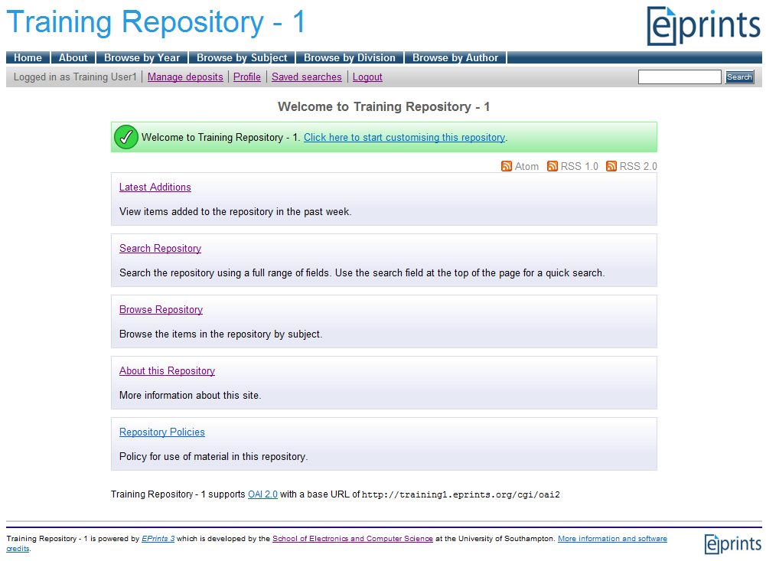
Repository Interaction Layers
Web
OAI-PMH
Institution
Repository
Notes:
The image on screen is an example of our vanilla branding and how EPrints looks when it is first installed. We’ll go into more detail on the contents of these pages when we get to the walkthroughs.

Slide 11
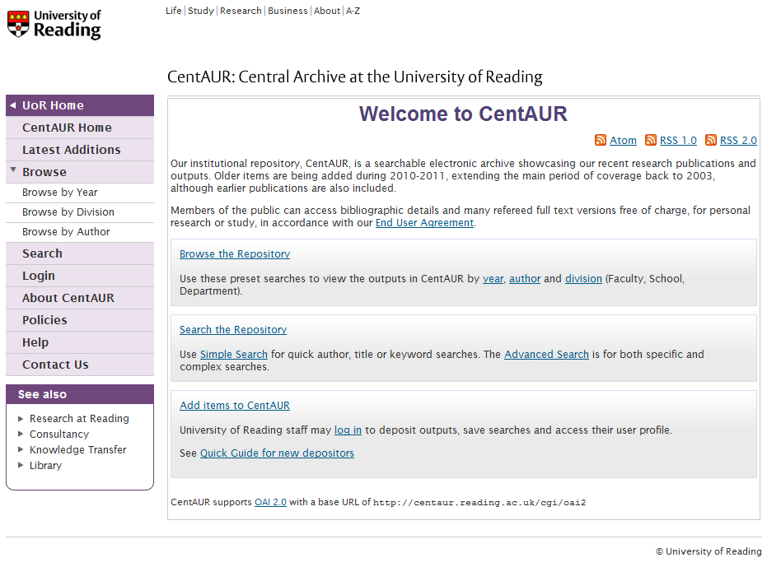
Repository Interaction Layers
Web
OAI-PMH
Institution
Repository
Notes:
In this example, the homepage is similar to the vanilla installation, but to customise the styling the institutions own logo has been add and co-ordinating colours have been used to tie the appearance of the menu which has been repositioned

Slide 12
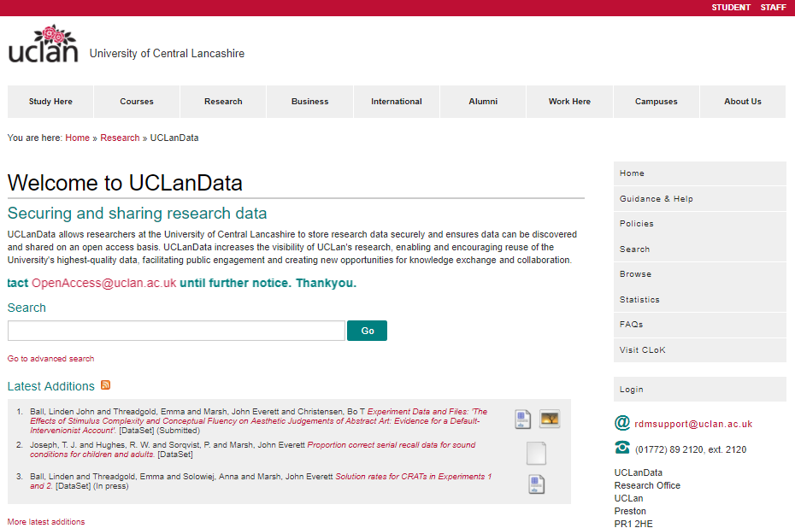
Repository Interaction Layers
Web
OAI-PMH
Institution
Repository
Notes:
In this example a more extensive set of changes to visual styles and layout have been applied to co-ordinate the repository seamlessly with this institutions corporate web pages.
Top menu links now reflect those used on the corporate site, and the repository navigation has been moved to the side as a submenu. The homepage has also been customised with a welcome message, prominent search box and live feed of the latest records to be published live on the repository.

Slide 13
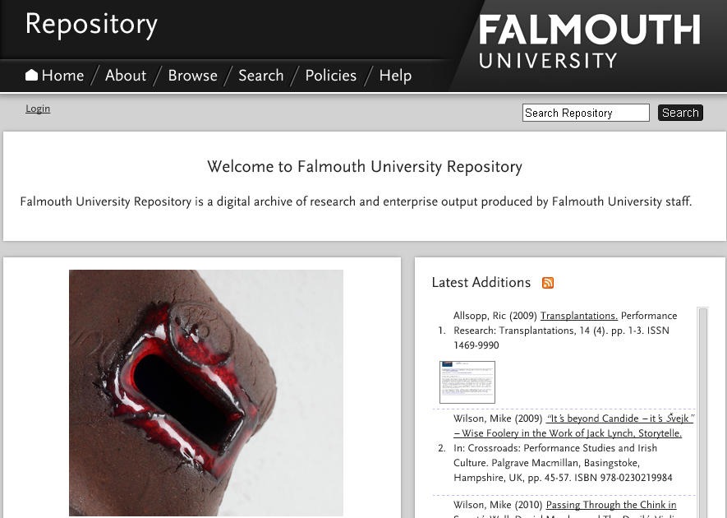
Repository Interaction Layers
Web
OAI-PMH
Institution
Repository
Notes:
This example is taken from an arts focused institution who opted for a stand-out identity for their repository. The rebranding has completely customised the entire appearance including the contents of the homepage
This example also highlights how files which are uploaded to records, as long as they are openly available, can be used to showcase their outputs providing a more visually interesting experience for your repository visitors. Your repository can be configured to use extensions to thumbnail sized previews of your files against search results or as shown in this case a larger sized preview on a homepage as part of a slideshow carousel

Slide 14
Any questions, please get in touch Otherwise please move on to Part 2: EPrints Roles
@EPrints
@EPrintsServices
www.eprints.org
Notes:
If you have any questions on what has been covered so far please get in touch.
Otherwise, once you are ready please carry on to Part 2: EPrints Roles

